Slide 1
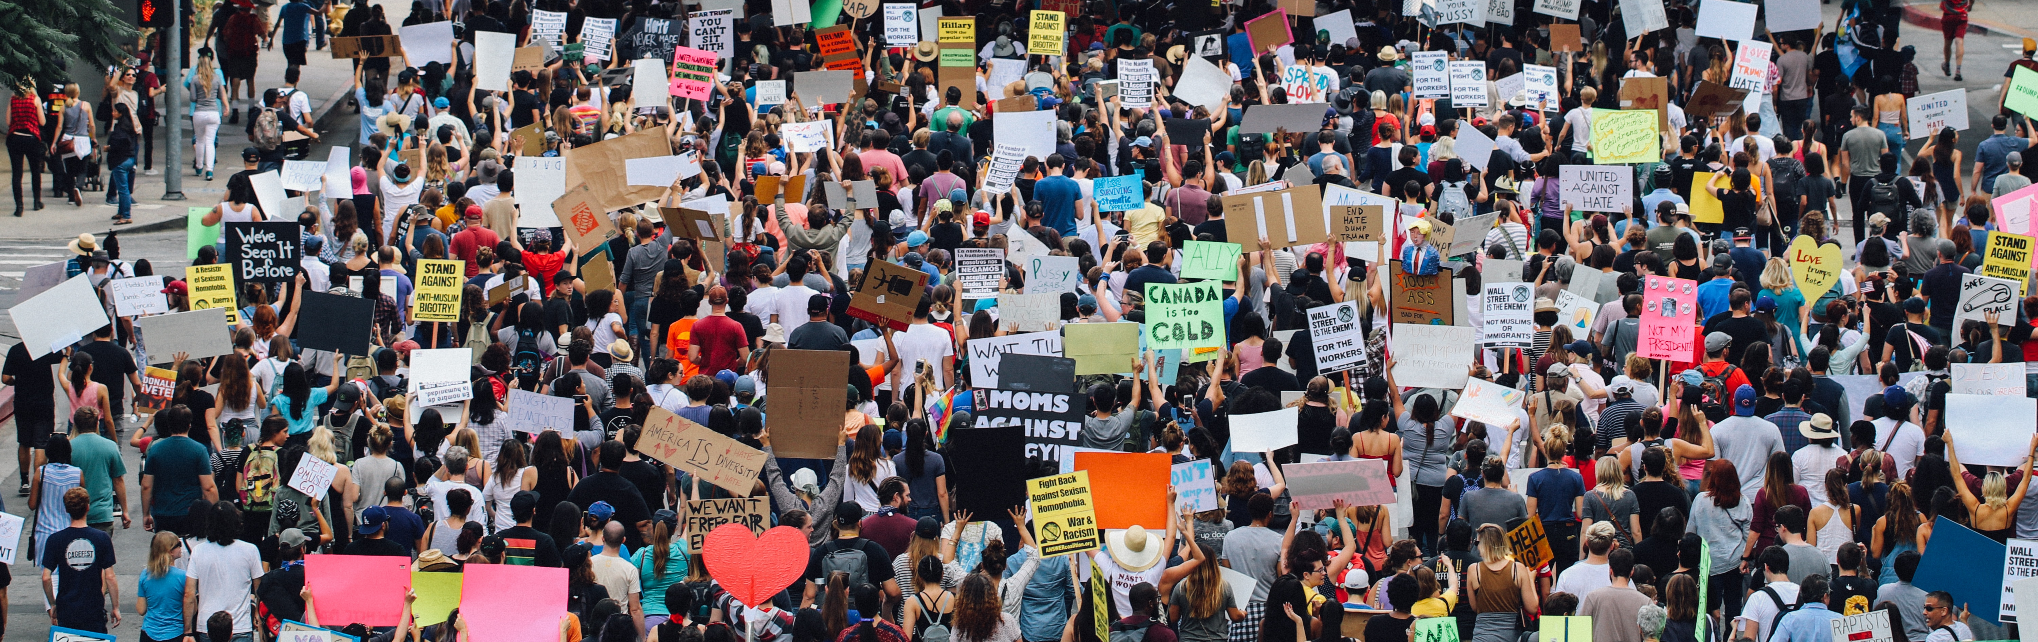
Getting to know your users:
An NLP guide to user text for better business operation
Rob Johns
Metis Data Science 2019
RobJohns989@gmail.com

Slide 2

Your website is both an ecosystem and a collection of groups of users
You can’t describe a mermaid without fish and human words
Fish and human words don’t describe one another well

Slide 3
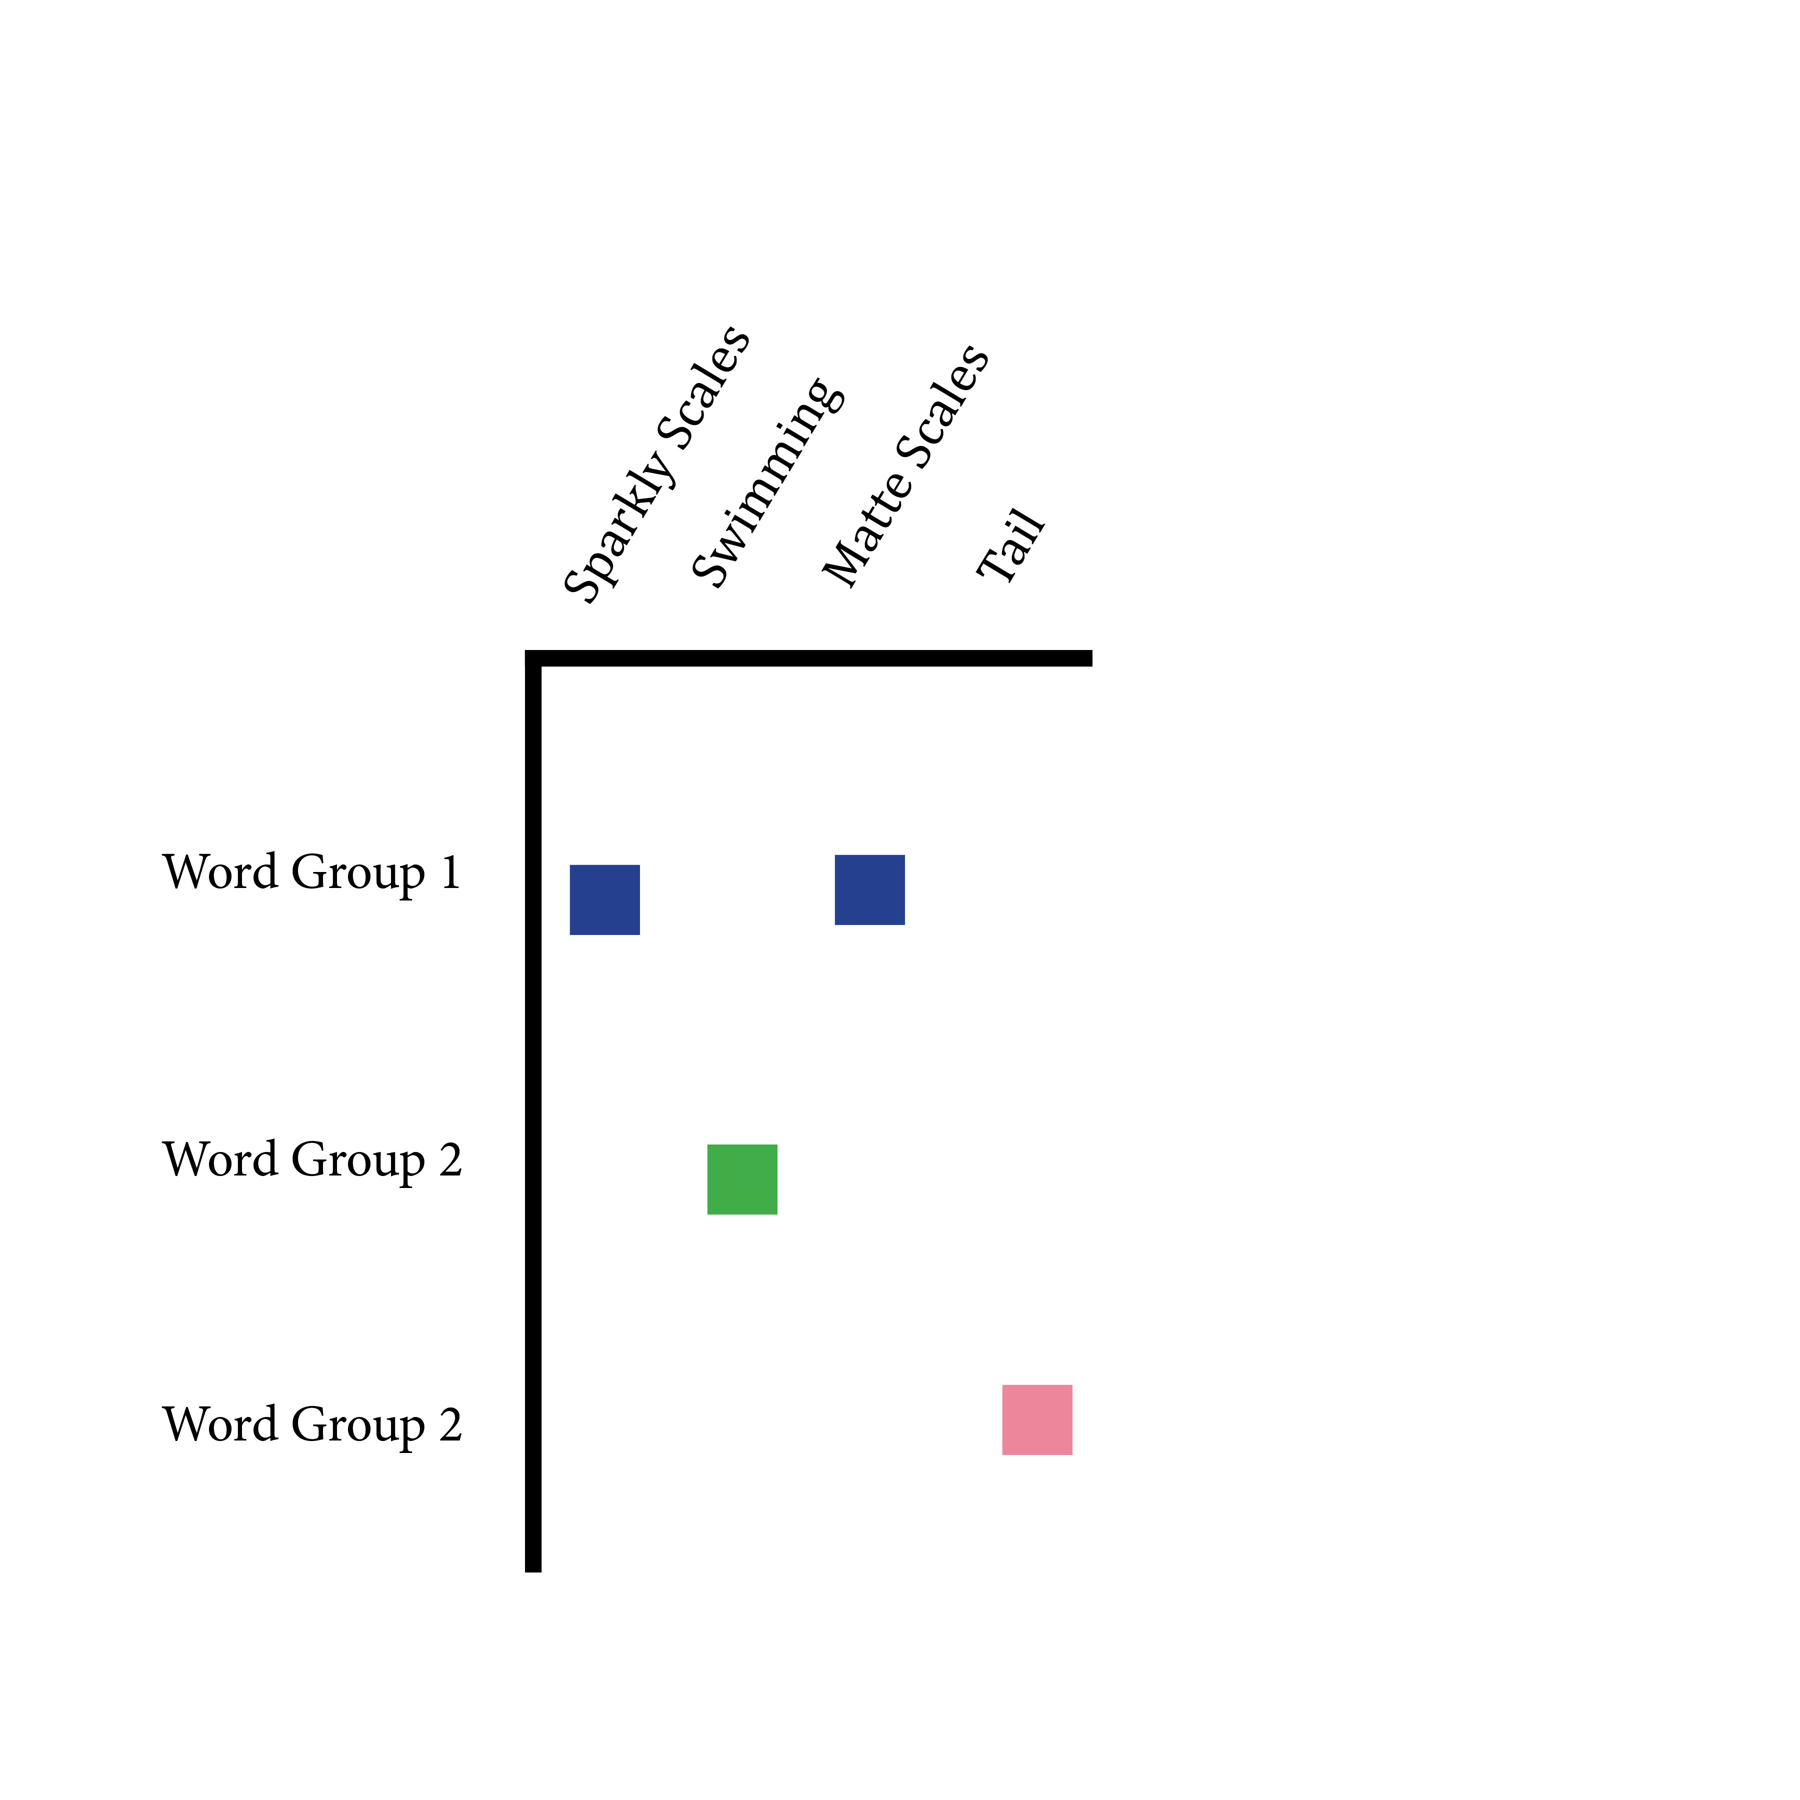
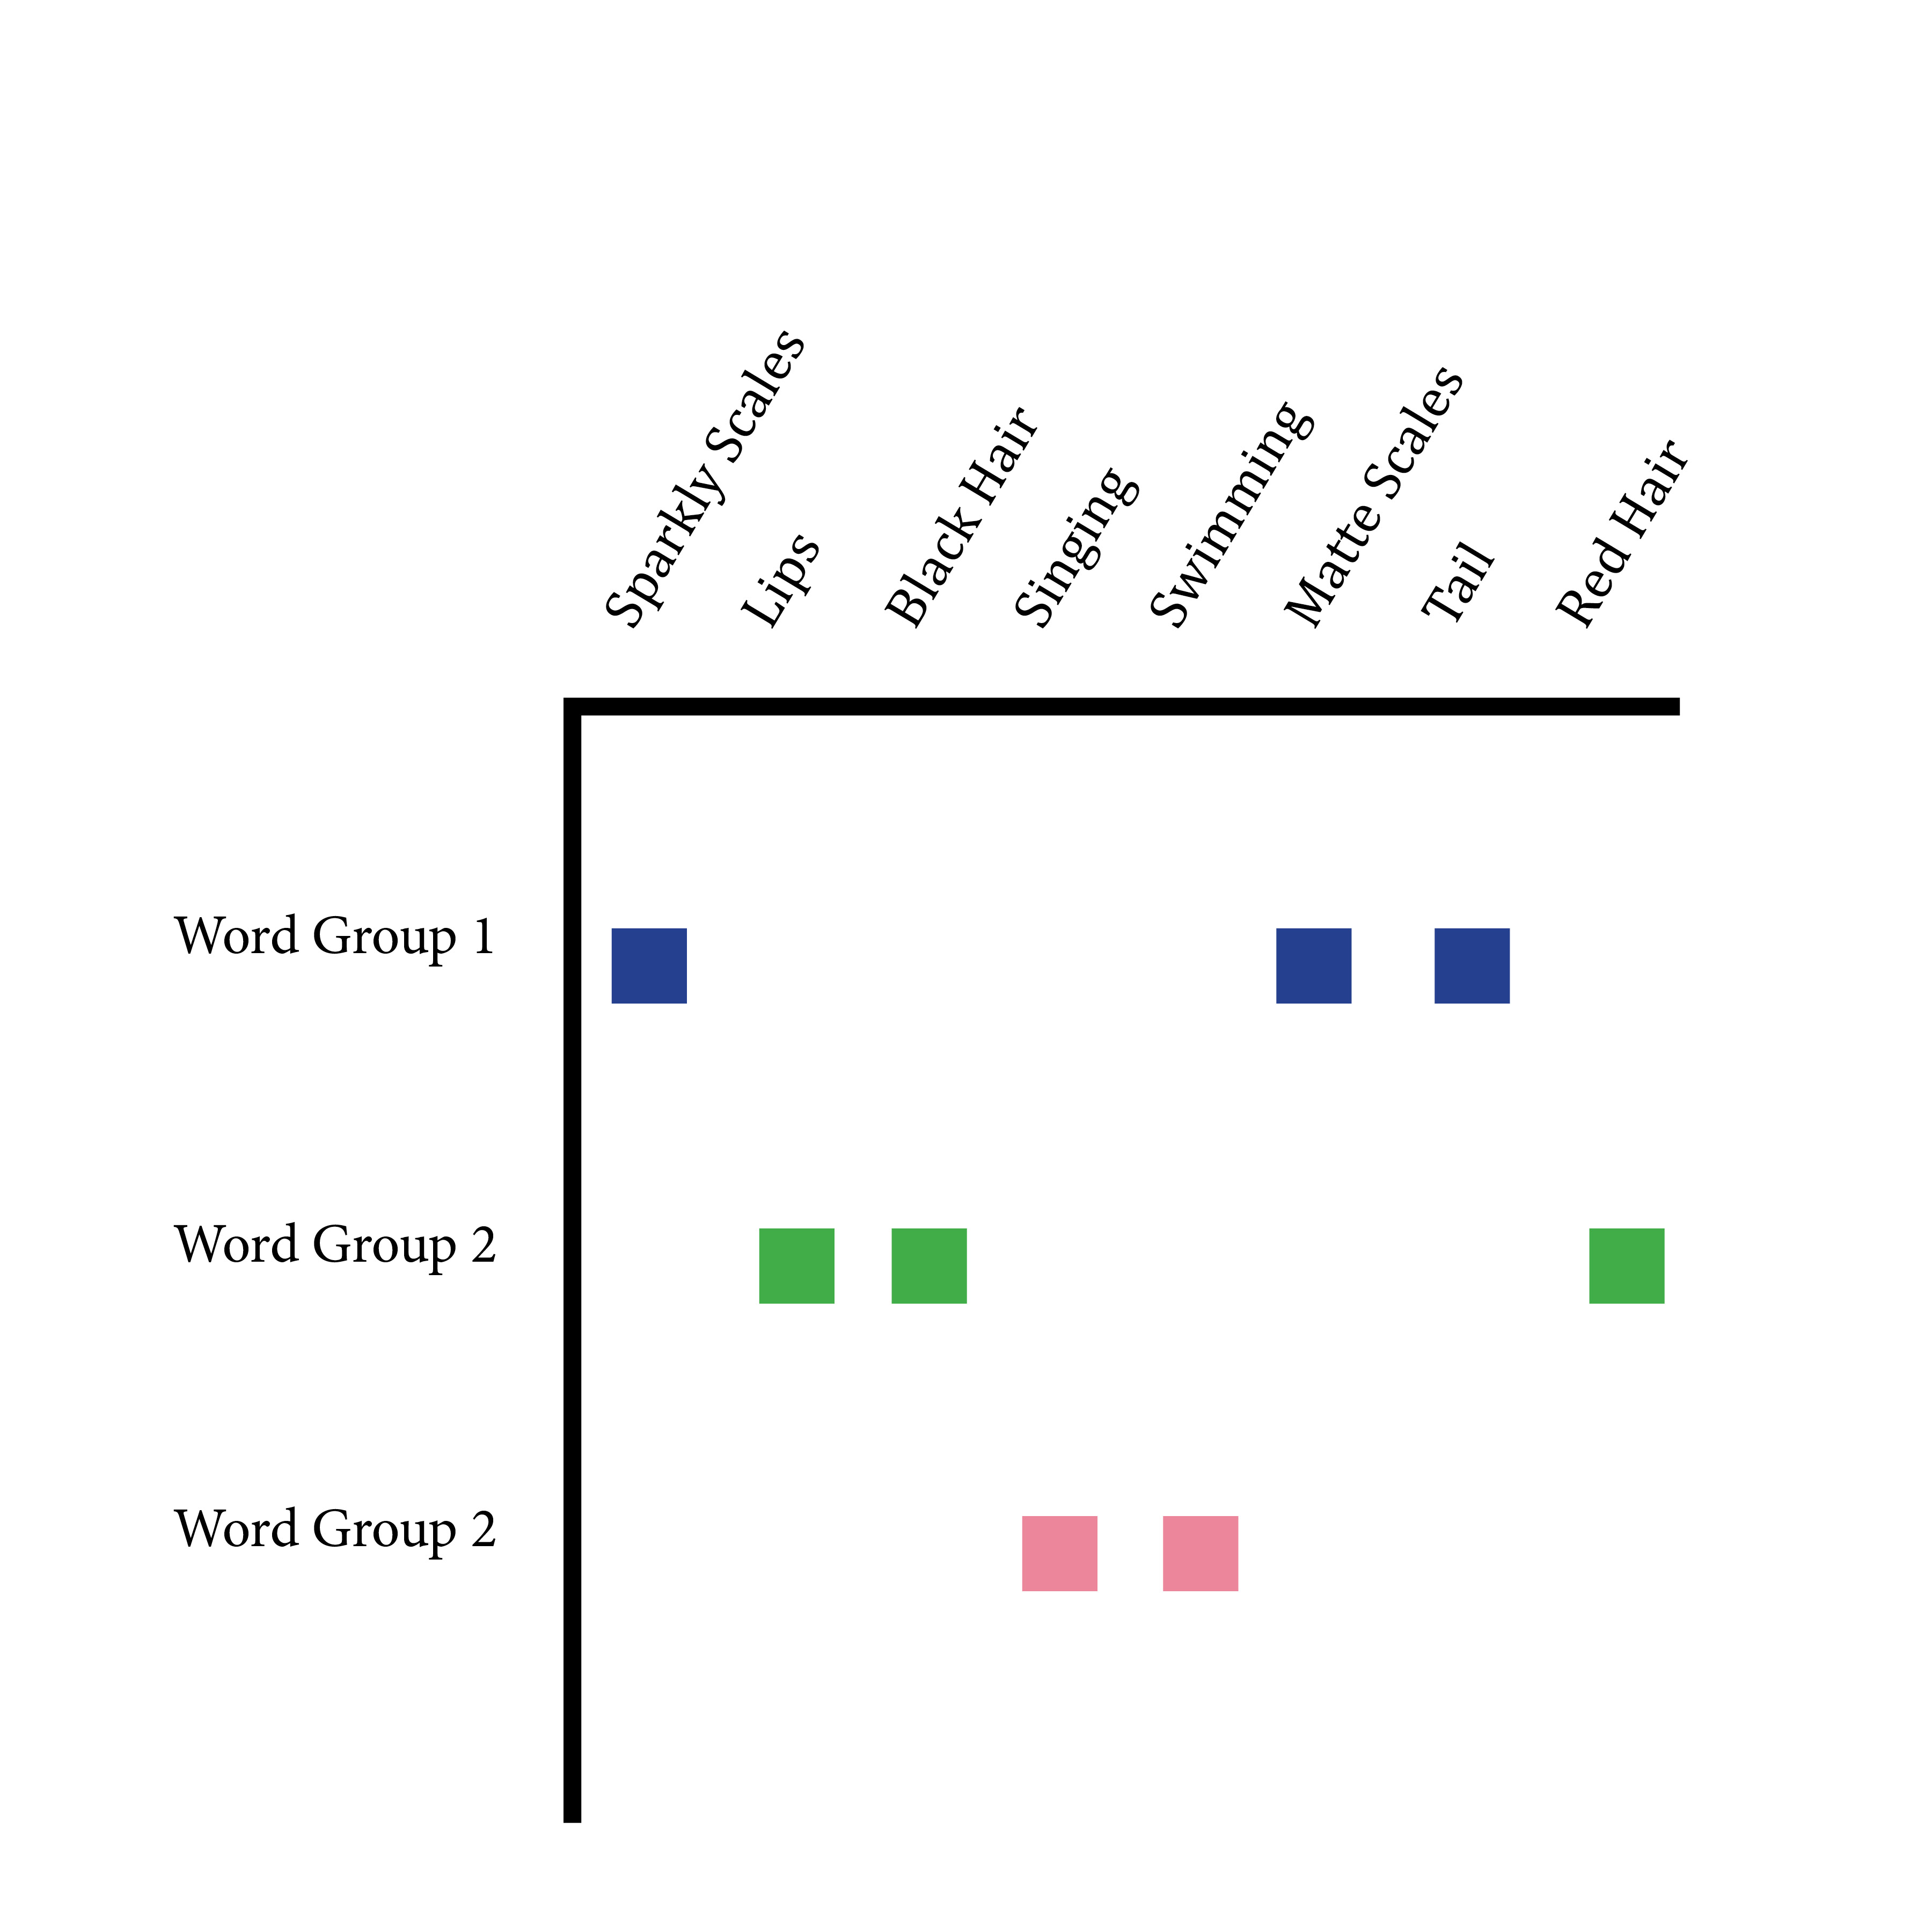
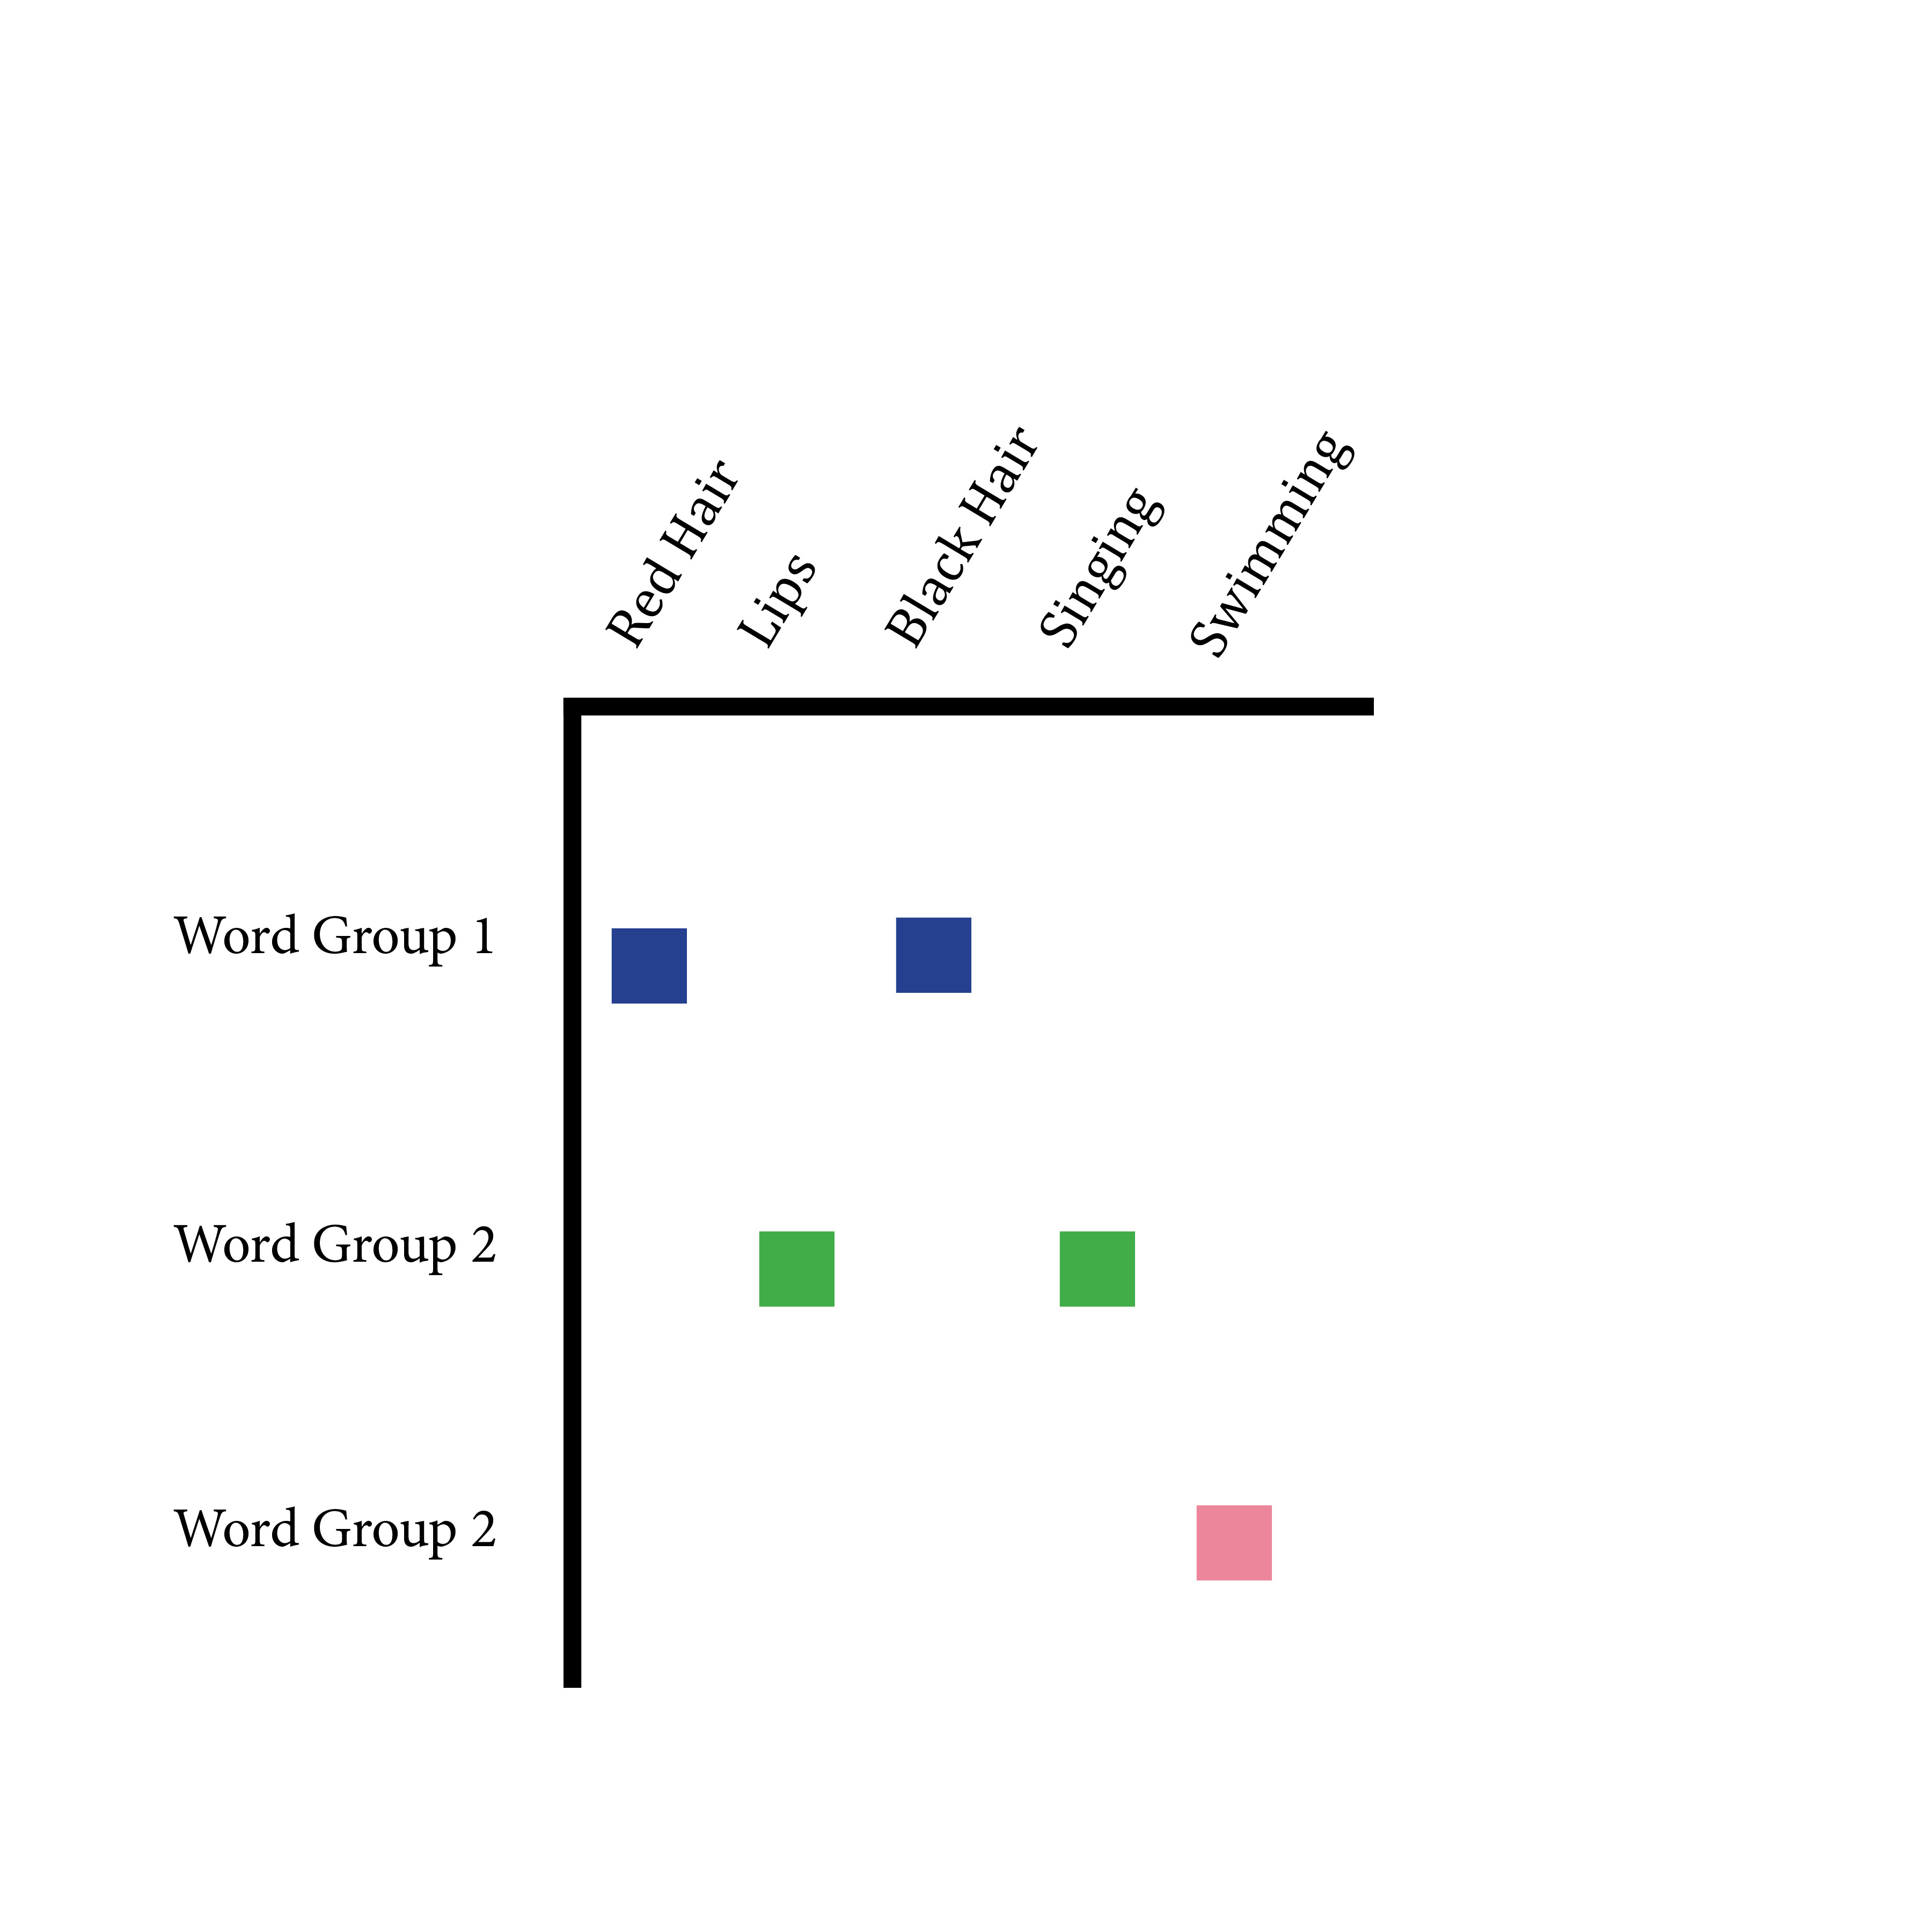

Slide 4

User Case: r/Science Moderation
223K comments
86K were removed by human an automated moderators
“Interesting that the planets have migrated inward as the star has shrunk. How does that work?”
Words formed into 1-3 ngrams and tokenized with term frequency–inverse document frequency Vectorization

Slide 5
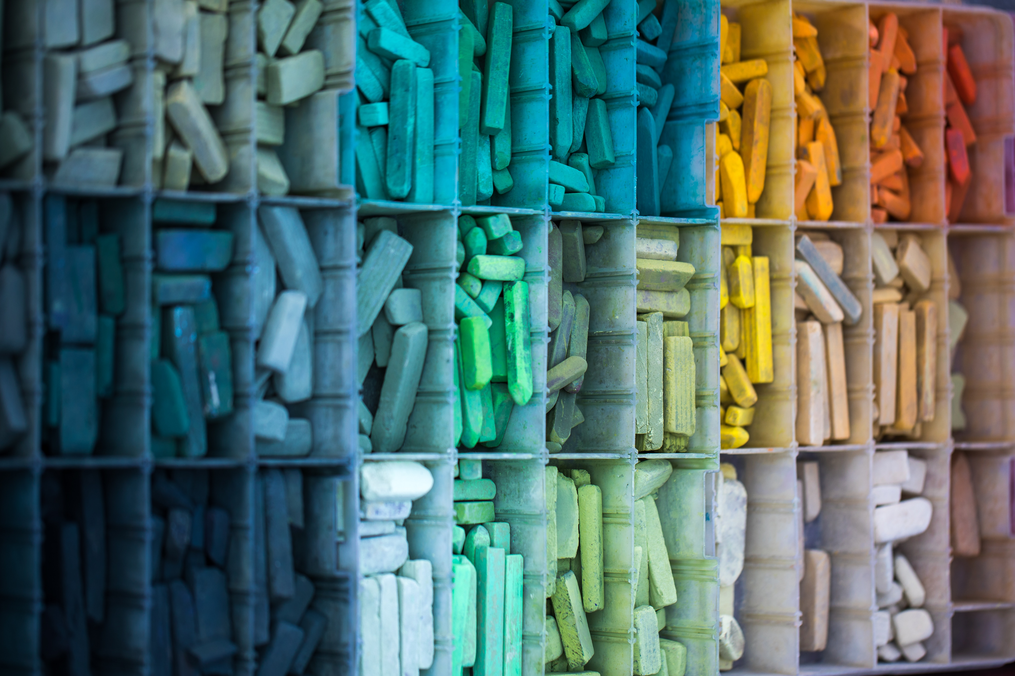
Relative weighting between groups with non-negative matrix factorization
Topics that favor removal:
shit, right, fuck, oh, yeah, eat
removed, comments, comments removed, deleted, comment, message, reddit, reddit com, www reddit com, www reddit
don, want, don want, don know, don think, care, people don
women, men, men women, sex, man, gender,
Topics that are safe:
message, reddit, reddit com, www reddit com, www reddit
com, www, https, https www, nature, http, nature com, www nature com,
does, mean, does mean, correlation, causation, doesn,
wikipedia, en, org wiki, wikipedia org, wikipedia org

Slide 6

Unmoderated vs. Moderated
change, climate, climate change, global, warming, global warming
really, need, interesting, isn, cool, really need, bad
makes, sense, makes sense, make, common, common sense
science, sub, political, isn, social, social science, politics
reddit, post, flair, message, mods, flair post
right, left, wrong, wing, right wing, guys, left right
read, article, didn, read article, title, didn read
Several swear word topics

Slide 7
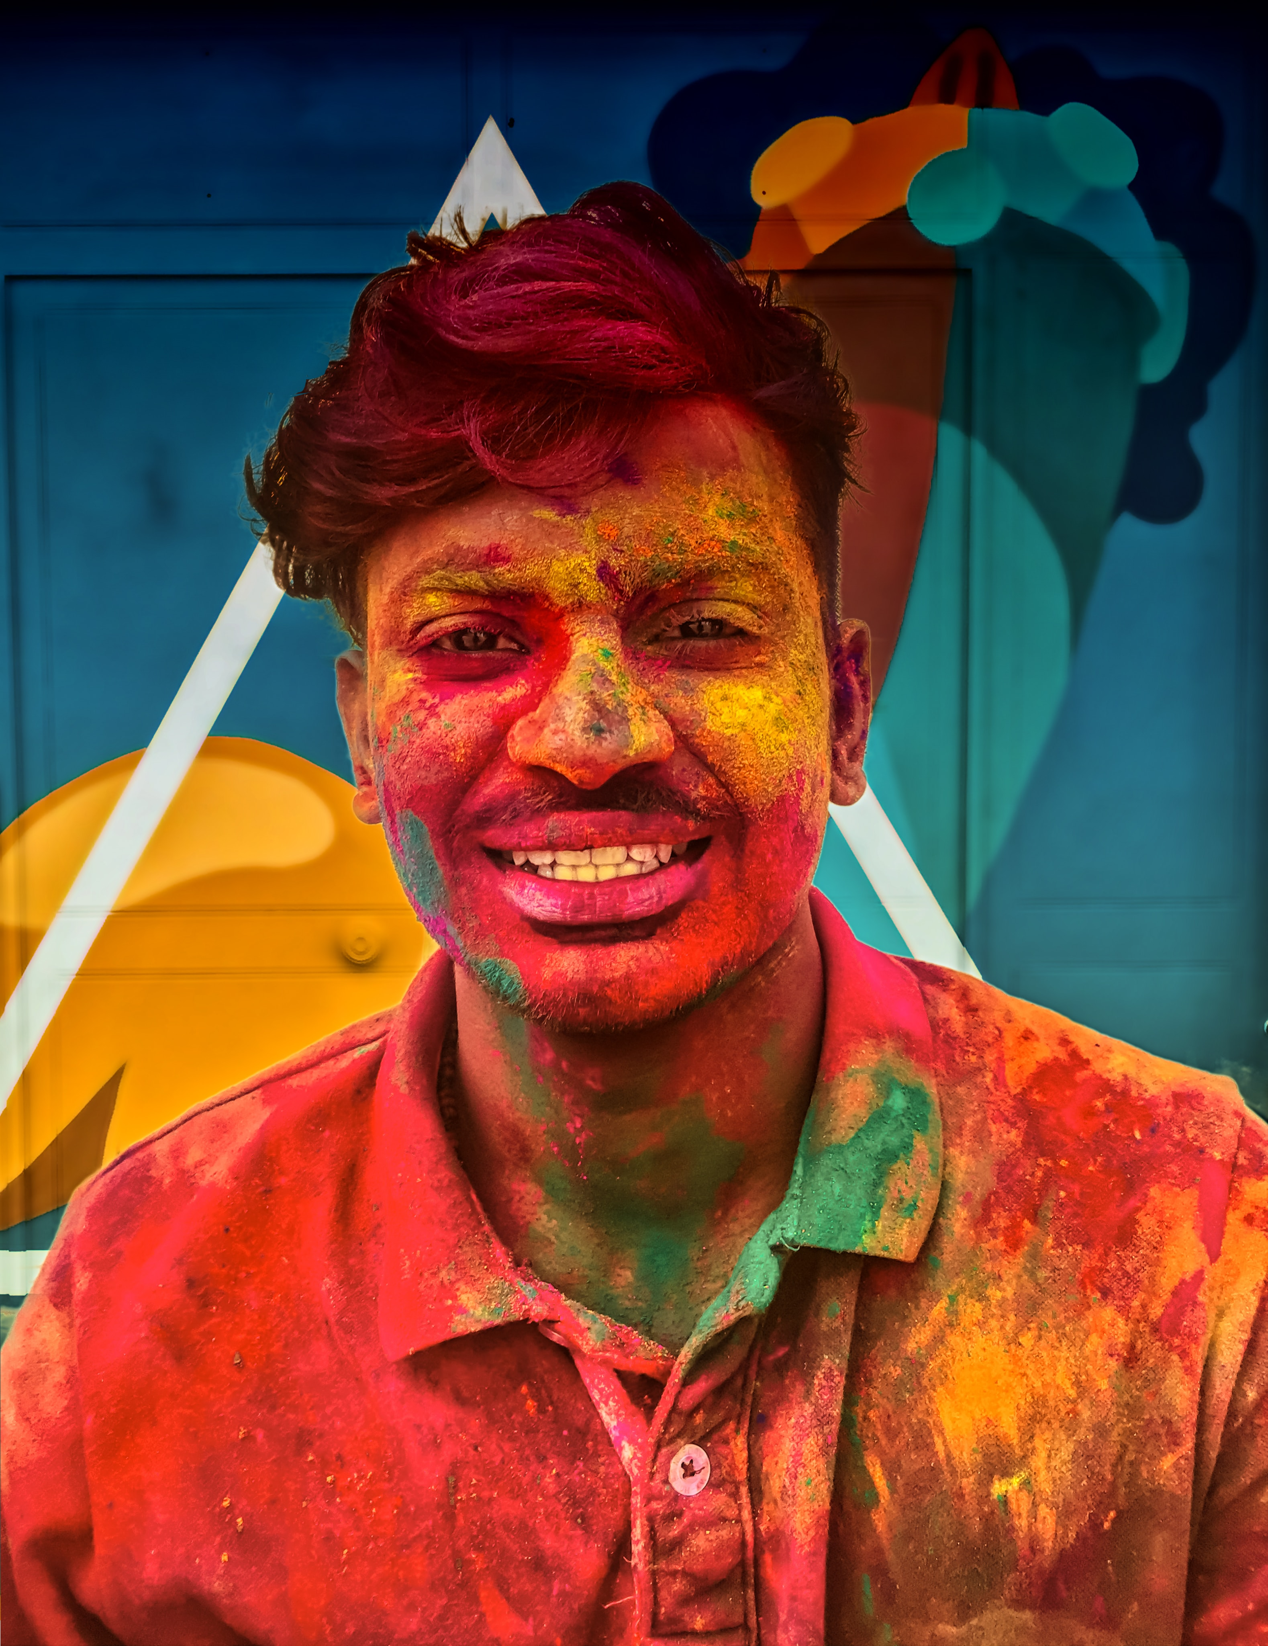
Conclusions
Website wide content comparisons can show you predictors of user classes: framework for identifying user groups from text alone
Clustering by known user categories helps you identify how certain users speak and use your service:
Relevant for market segments
Relevant for user experience
Relevant to discussion expectations

